Slide 1


WEEK 9: MIDTERM REVIEW
PHYSICAL EDUCATION

Slide 2

CLASSROOM EXPECTATION REVIEW

Slide 3
WHAT IS THE FIRST THING YOU DO WHEN YOU ENTER THE GYM?
A) Have a seat quietly in my teachers’ attendance area
B) Run around gym
C) Be in another classroom attendance area

Slide 4
AFTER LEAVING THE LOCKER ROOM WHAT SHOULD YOU DO?
A) Have a seat quietly in attendance area unless instructed otherwise
B) Run around gym
C) Be in another classroom attendance area

Slide 5
SHOULD YOU BE TALKING WHILE ANY OF THE COACHES ARE TALKING OR BEING DISRUPTIVE DURING A PRESENTATION?
A) NO
B) YES

Slide 6
SHOULD YOU BE INSIDE OR OUTSIDE THE BLACK LINES DURING THE 20-MINUTE WALK?
A) OUTSIDE
B) INSIDE

Slide 7
SHOULD YOU BE RUNNING DURING THE 20-MINUTE WALK?
A) NO
B) YES

Slide 8
SHOULD YOU BE OUTSIDE THE GYM WITHOUT PERMISSION?
A) NO
B) YES

Slide 9






THE 5 MAJOR FITNESS COMPONENTS REVIEW
CARDIOVASCULAR ENDURANCE
FLEXIBILITY
BODY COMPOSITION
MUSCULAR STRENGTH
MUSCULAR ENDURANCE

Slide 10

NAME THE 5 MAJOR FITNESS COMPONENTS.
CARDIOVASCULAR ENDURANCE
FLEXIBILITY
BODY COMPOSITION
MUSCULAR STRENGTH
MUSCULAR ENDURANCE

Slide 11

INTRODUCTORY VOCABULARY REVIEW

Slide 12
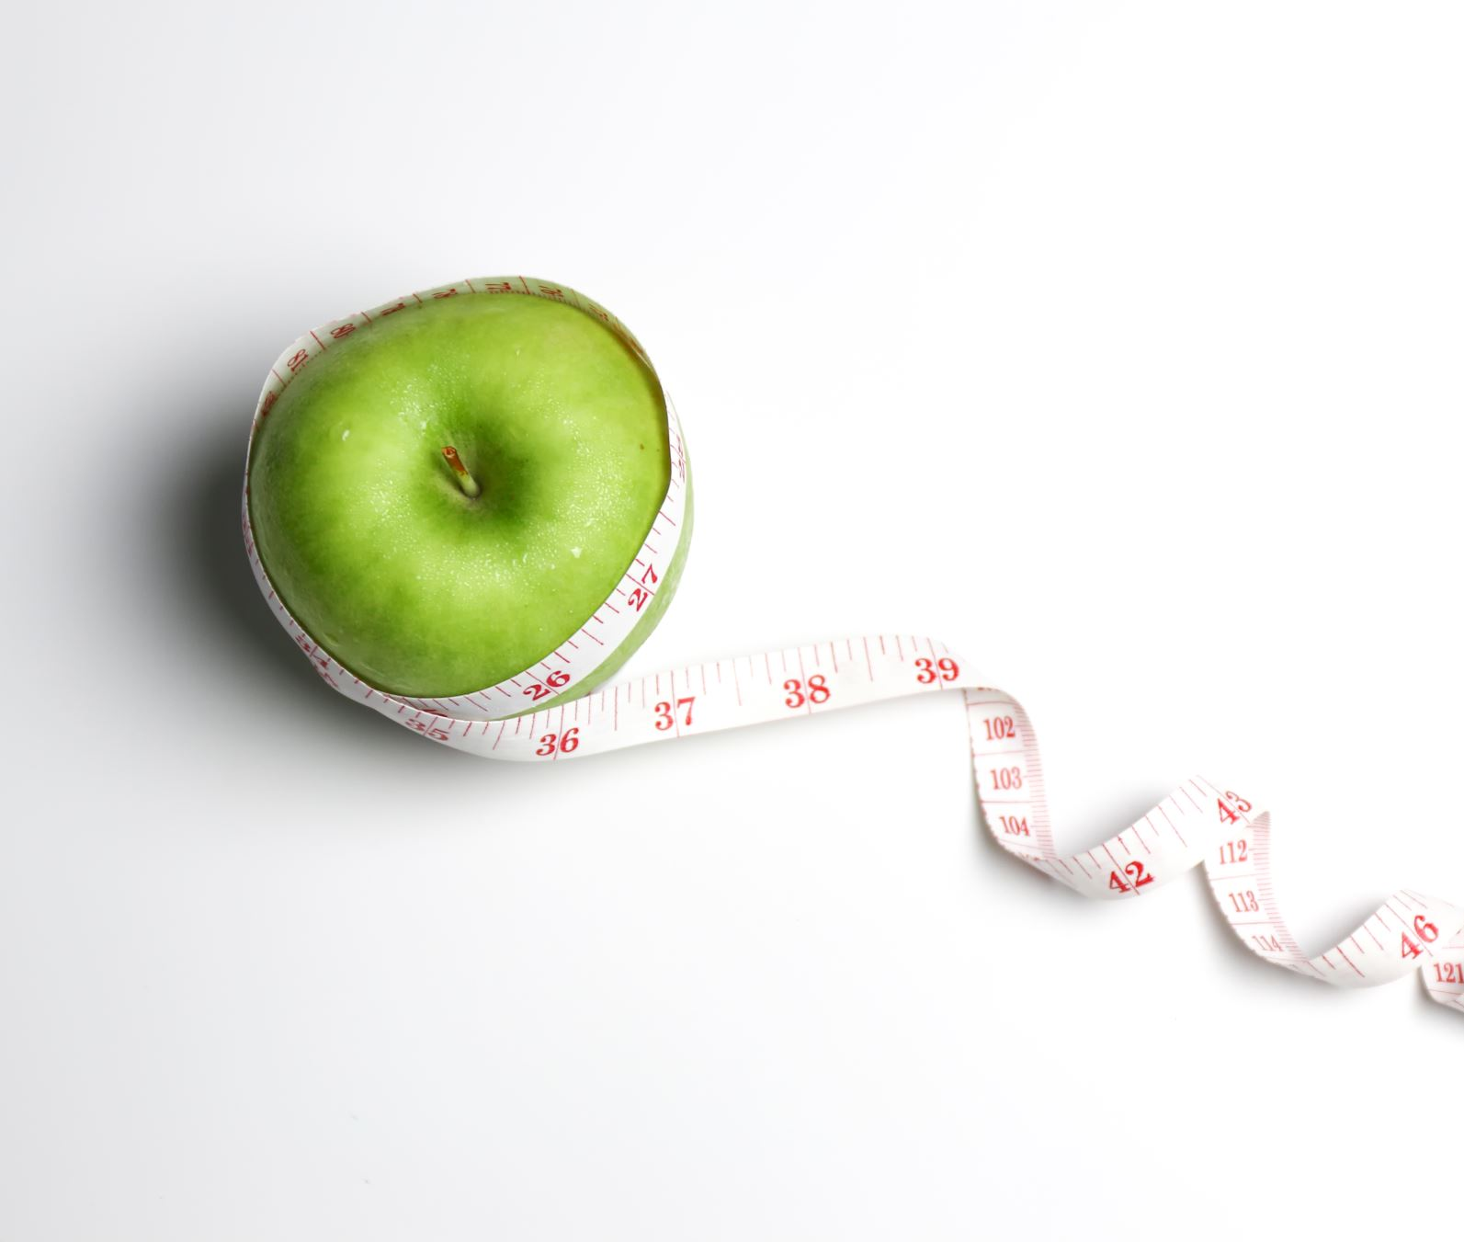
BODY COMPOSITION
The ratio of fat, muscle, and other tissues in the body.

Slide 13


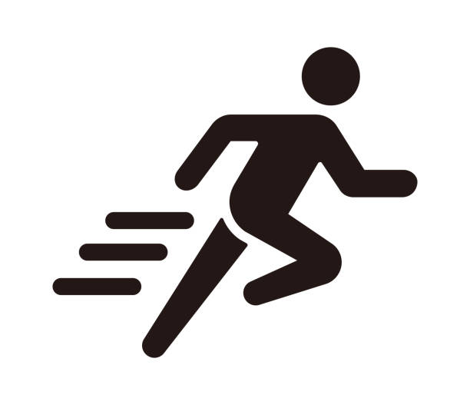
CARDIOVASCULAR HEALTH
Relating to the heart and blood vessels; cardiovascular exercises include activities that increase heart rate.

Slide 14


FLEXIBILITY
The range of motion in joints and muscles.

Slide 15
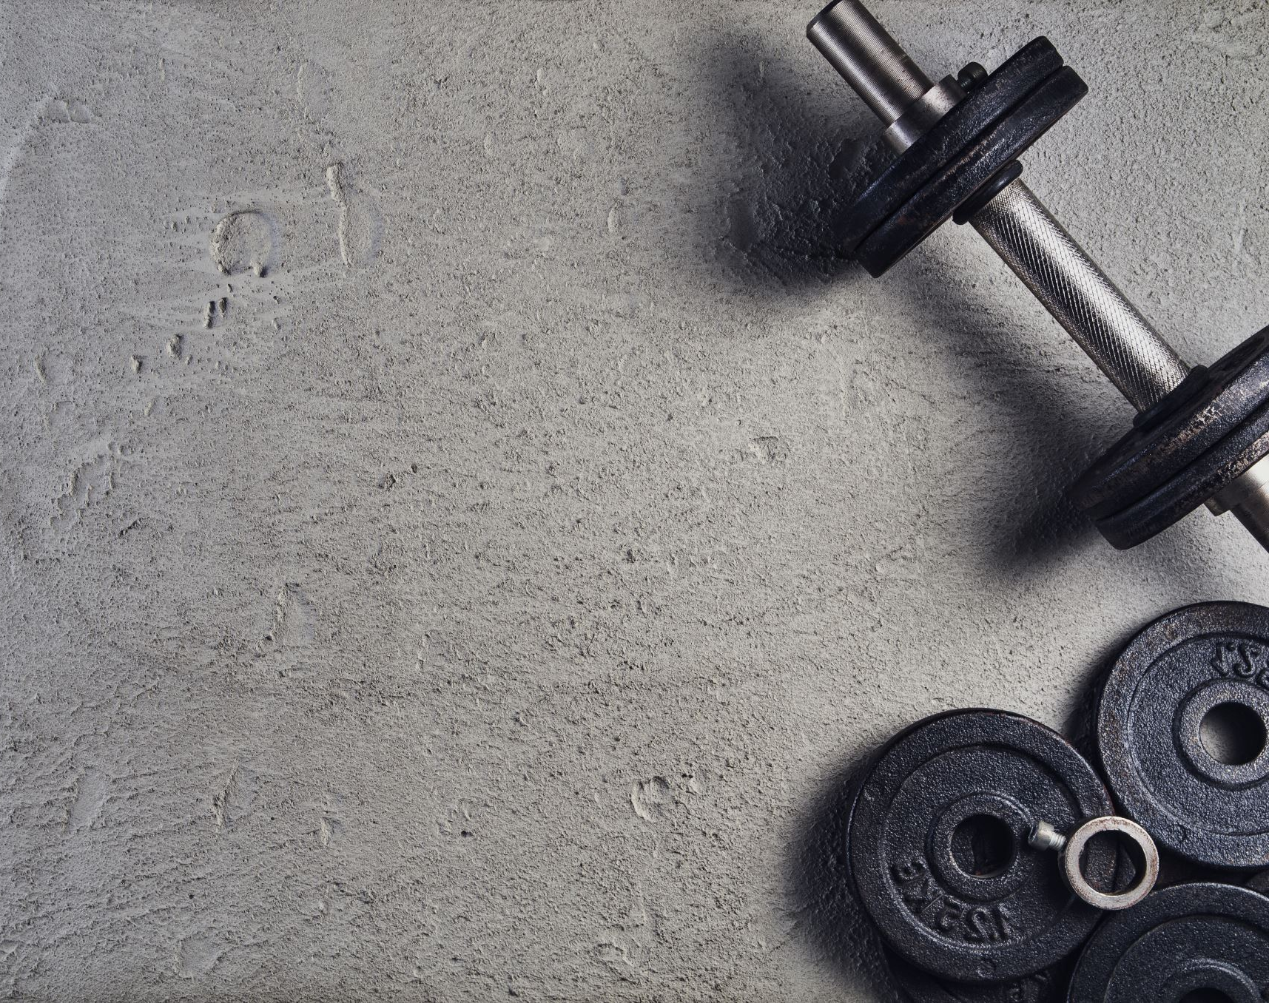
MUSCULAR ENDURANCE
The ability to sustain physical activity for an extended period.

Slide 16
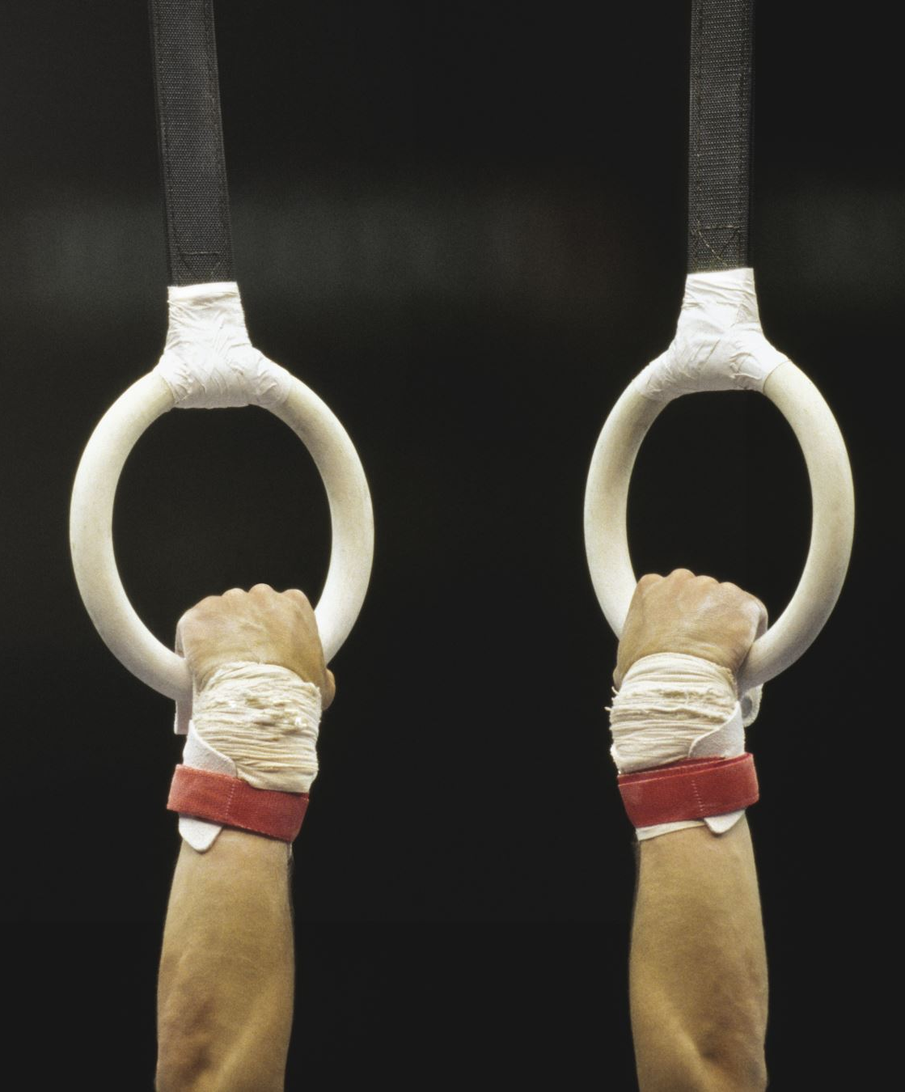
MUSCULAR STRENGTH
The ability of muscles to exert force against resistance.

Slide 17
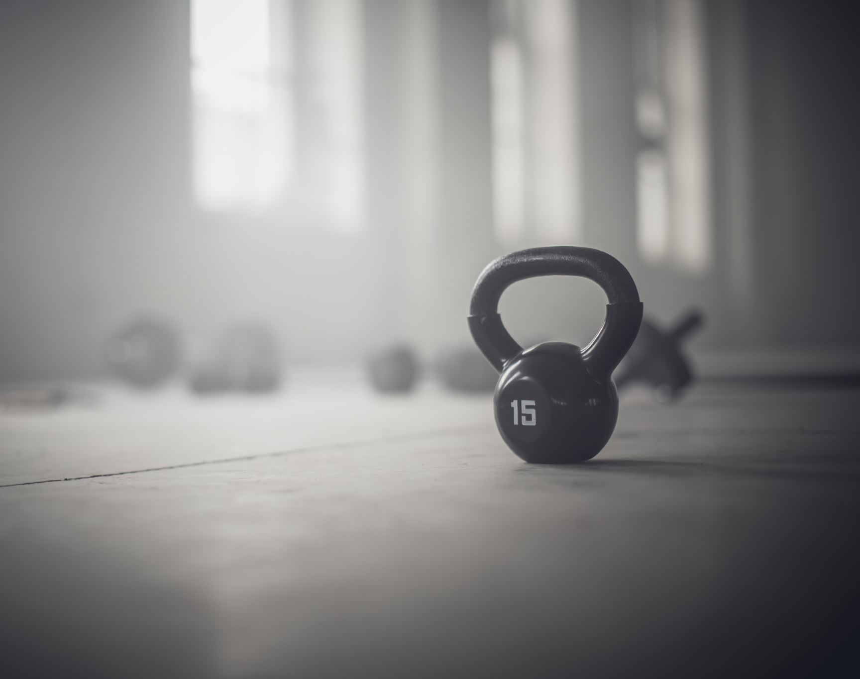
FITNESS
The state of being physically healthy and in good shape.

Slide 18
FITNESS COMPONENTS COMPREHENSION QUIZ
1) WHAT YOUR BODY IS MADE OF, LIKE MUSCLES, BONES, AND FAT.
A) CARDIOVASCULAR ENDURANCE
B) FLEXIBILITY
C) BODY COMPOSITION
D) MUSCULAR STRENGTH
E) MUSCULAR ENDURANCE
2) HOW STRONG YOUR HEART AND LUNGS ARE.
A) CARDIOVASCULAR ENDURANCE
B) FLEXIBILITY
C) BODY COMPOSITION
D) MUSCULAR STRENGTH
E) MUSCULAR ENDURANCE

Slide 19

FITNESS COMPONENTS COMPREHENSION QUIZ
3) HOW LONG YOUR MUSCLES CAN KEEP WORKING WITHOUT GETTING TIRED.
A) CARDIOVASCULAR ENDURANCE
B) FLEXIBILITY
C) BODY COMPOSITION
D) MUSCULAR STRENGTH
E) MUSCULAR ENDURANCE
4) THE RANGE OF MOTION IN YOUR JOINTS AND MUSCLE.
A) CARDIOVASCULAR ENDURANCE
B) FLEXIBILITY
C) BODY COMPOSITION
D) MUSCULAR STRENGTH
E) MUSCULAR ENDURANCE

Slide 20
FITNESS COMPONENTS COMPREHENSION QUIZ
5) HOW STRONG YOUR MUSCLES ARE. HOW MUCH YOU CAN LIFT OR PUSH.
A) CARDIOVASCULAR ENDURANCE
B) FLEXIBILITY
C) BODY COMPOSITION
D) MUSCULAR STRENGTH
E) MUSCULAR ENDURANCE
6) THE STATE OF BEING PHYSICALLY HEALTHY AND IN GOOD SHAPE.
A) CARDIOVASCULAR ENDURANCE
B) FITNESS
C) MUSCULAR STRENGTH
D) MUSCULAR ENDURANCE

Slide 21
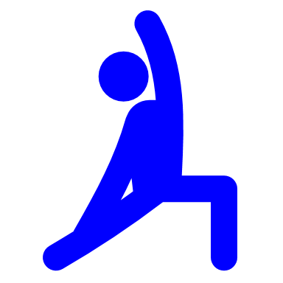

FLEXIBILITY REVIEW

Slide 22
WHAT MAJOR COMPONENT DOES STATIC STRETCHING FALL UNDER IN PYHSICAL EDUCATION?
FLEXIBILITY

Slide 23
WHAT MAJOR COMPONENT DOES DYNAMIC STRETCHING FALL UNDER IN PYHSICAL EDUCATION?
FLEXIBILITY

Slide 24
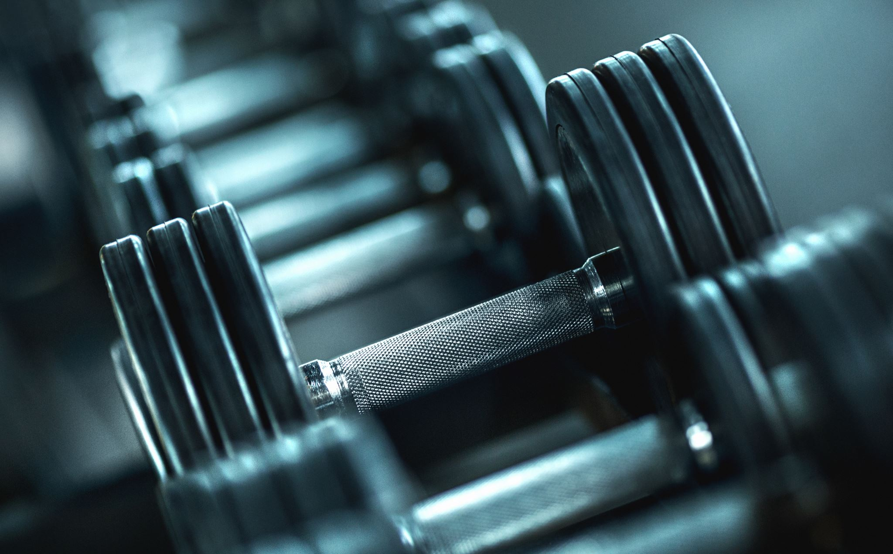
DYNAMIC vs. STATIC STRETCHING
DYNAMIC STRETCHING INVOLVES ACTIVE MOVEMENT WHILE SIMULATNEOUSLY STRETCHING THE FOCUSED MUSCLE GROUP
STATIC STRETCHING INVOLVES HOLDING A STRETCH IN A STATIONARY POSITION
BOTH STRETCHING STYLES ARE COMPLEMENTARY TO THE PREPARATION AND RECOVERY OF PHYSICAL ACTIVITY

Slide 25
QUIZ QUESTION
DYNAMIC STRETCHING INVOLVES _____________ MOVEMENT WHILE SIMULATNEOUSLY STRETCHING THE FOCUSED MUSCLE GROUP WHILE STATIC STRETCHING INVOLVES _______________ MOVEMENT DURING STRETCHES.
ACTIVE; ACTIVE.
STATIONARY; STATIONARY.
ACTIVE; STATIONARY.
STATIONARY; ACTIVE
NONE OF THE ABOVE.

Slide 26
QUIZ QUESTION
WHICH OF THE FOLLOWING ARE POTENTIAL BENEFITS OF STRETCHING?
DECREASE RISK OF MUSCLE INJURY.
IMPROVE LONG DISTANCE RUNNING PERFORMANCE.
IMPROVE STRENGTH AT SHORT MUSCLE LENGTHS.
NONE OF THE ABOVE.
ALL OF THE ABOVE.

Slide 27
QUIZ QUESTION
WHICH OF THE FOLLOWING STRETCHING SCENARIOS COULD BE DETRIMENTAL?
PERFORMING 8 LOW BACK STRETCHES EACH LASTING 1 MINUTE WITH 30 SECONDS REST IN BETWEEN.
REGULARLY STRETCHING TO THE EXTREMES OF JOINT MOTION IN VERY FLEXIBLE INDIVIDUALS.
STRETCHING FOR 15 MINUTES BEFORE YOU GO TO BED.

Slide 28
QUIZ QUESTION
WHAT ARE SOME THINGS TO LOOK OUT FOR, OR TO AVOID, WHEN STRETCHING?
AVOID BOUNCING, JERKING MOVEMENTS DURING STRETCHING, AND OVERSTRETCHING

Slide 29

TRUE or FALSE: DYANMIC STRETCHING ENHANCE PERFORMANCE AND FLEXIBILITY?
TRUE

Slide 30

WHICH STATEMENT IS A MYTH REGARDING DYNAMIC STRETCHING?
DOES NOT DECREASE STRENGTH
DOES NOT CAUSE MUSCLE TIGHTNESS
DOES NOT REPLACE WARM-UP
ALL OF THE ABOVE
Notes:
Teacher emphasizes the importance of this slide.

Slide 31
BENEFITS OF STATIC + DYNAMIC STRETCHING:
IMPROVED FLEXIBILITY
ENHANCED MUSCLE RELAXATION
INJURY PREVENTION
IMPROVED POSTURE
INCREASED BLOOD CIRCULATION
RELAXATION AND STRESS RELIEF
BETTER JOINT RANGE OF MOTION
LONG-TERM MOBILITY
MIND-BODY CONNECTION
BETTER PERFORMANCE
ACTIVE LIFESTYLE SUPPORT
Notes:
Have students read ALL the bullet points.

Slide 32
SAFETY AND GUIDELINES:
WARM UP BEFORE STATIC STRETCHING.
AVOID BOUNCING OR JERKING MOVEMENTS DURING STRETCHING.
BREATH DEEPLY AND CONSISTENTLY DURING STRETCHES.
LISTENING TO YOUR BODY AND AVOID EXCESSIVE DISCOMFORT OR PAIN.
STRETCHING SHOULD NOT BE PAINFUL.
Notes:
Teacher emphasizes the importance of this slide.

Slide 33
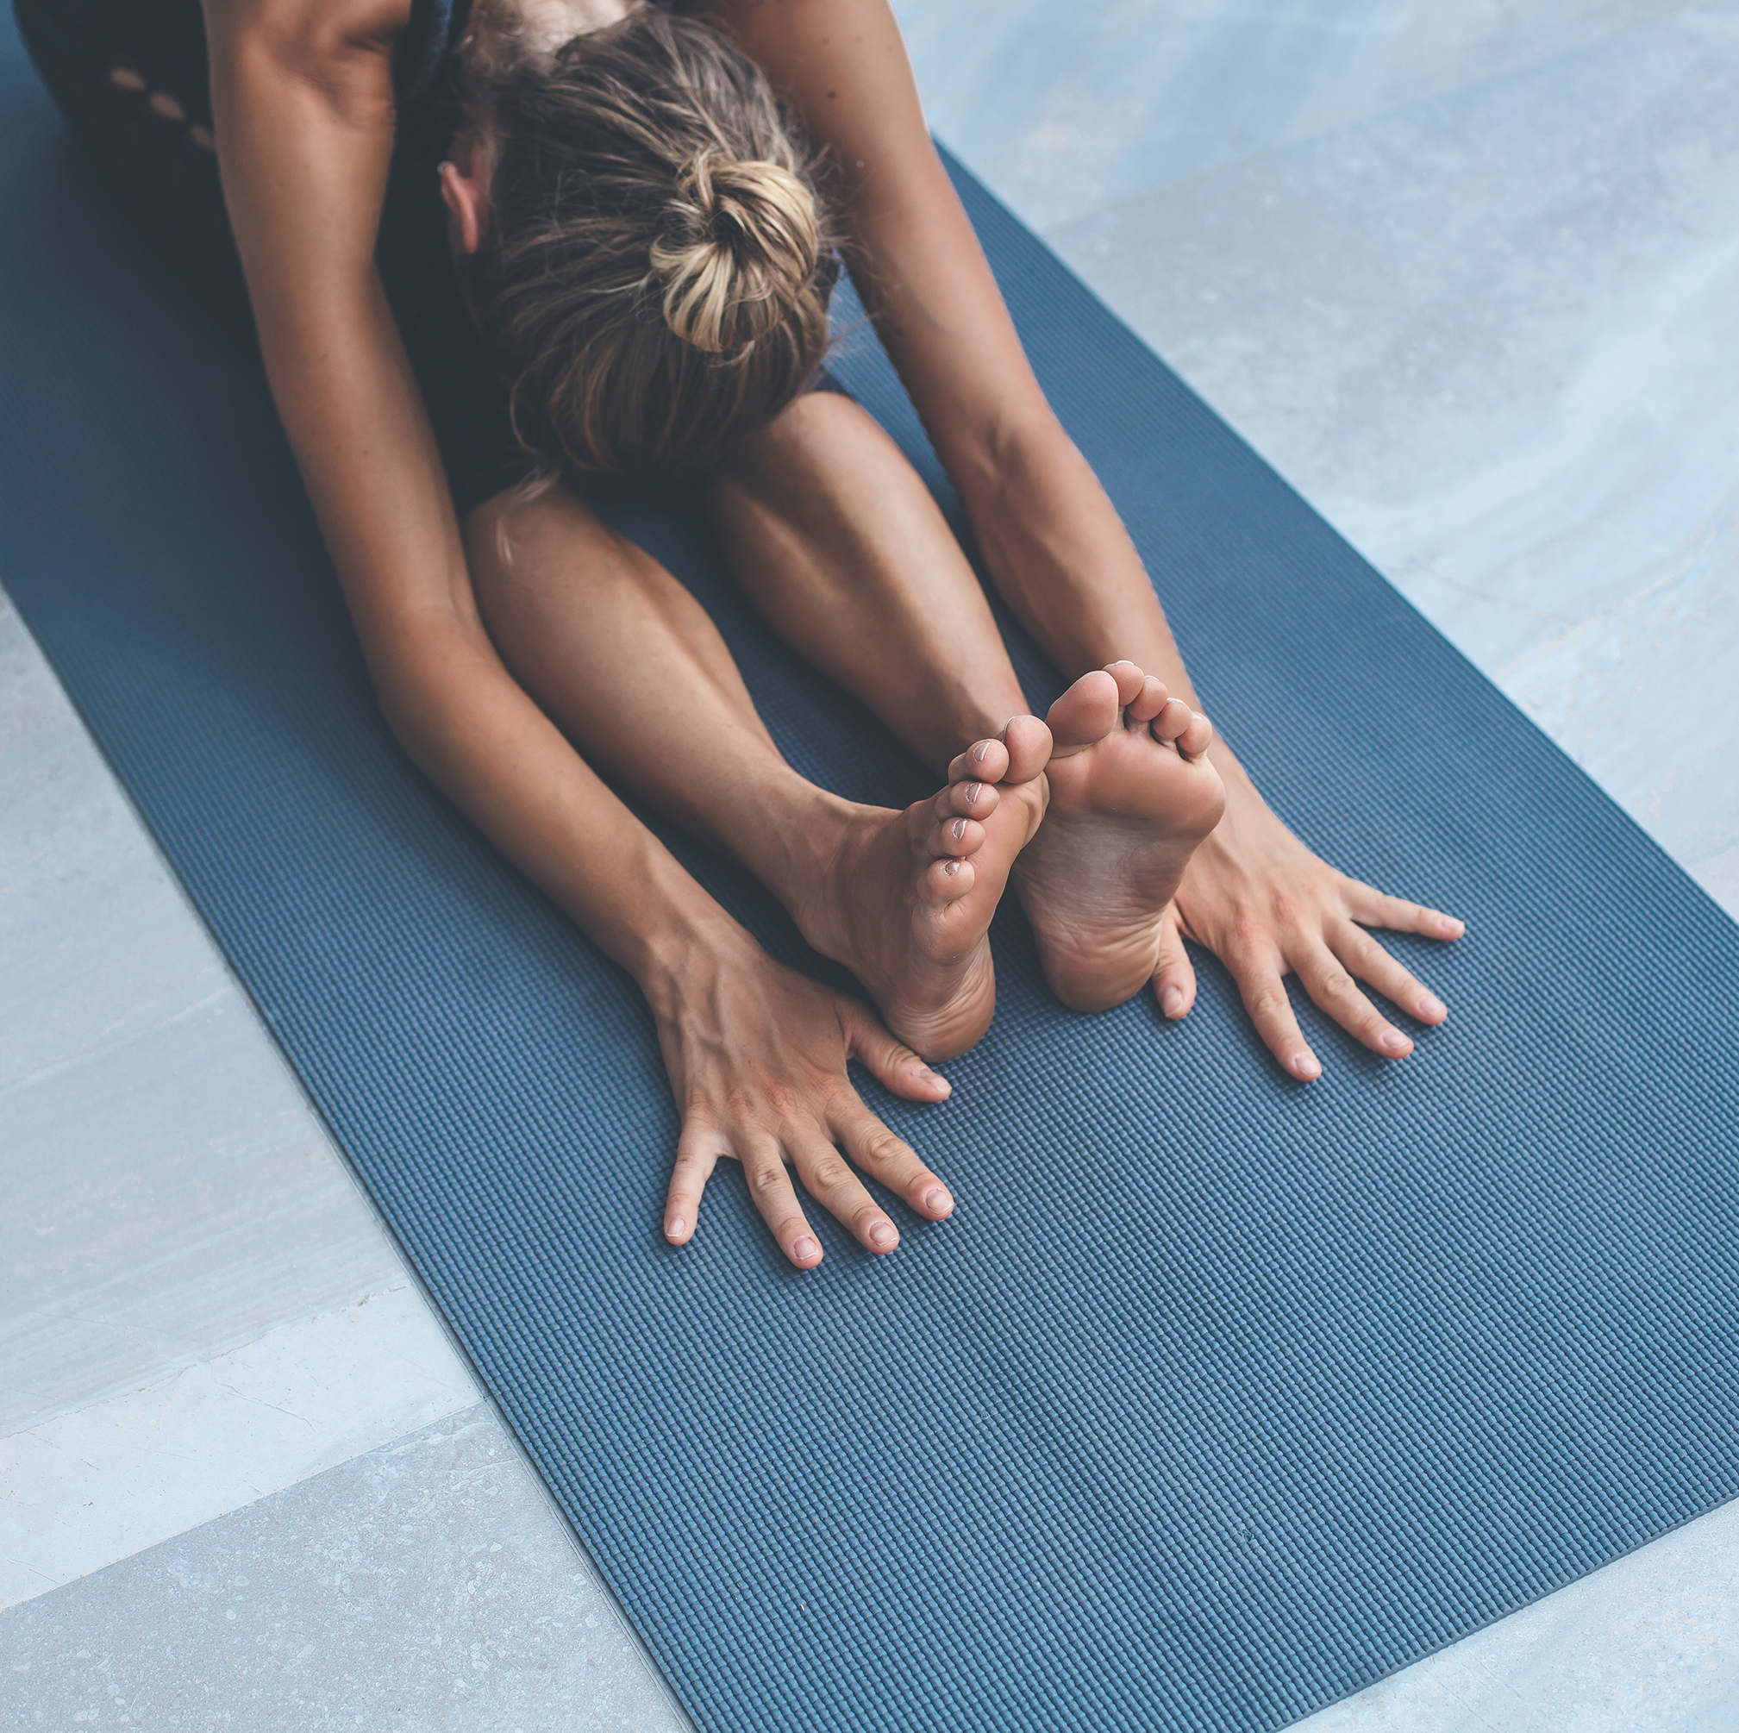
STTETCHING SHOULD BE PAINFUL?
TRUE
FALSE
Notes:
Teacher emphasizes the importance of this slide.

Slide 34
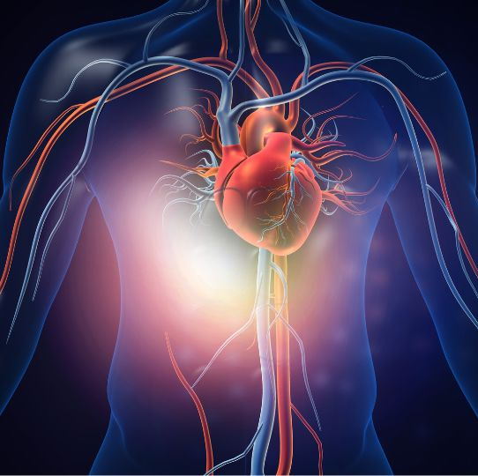
1) WHAT ORGAN IS THE YELLOW ARROW POINTING TO?
THE HEART.
2)WHAT MAJOR PHYSICAL COMPONENT IS THIS MUSCLE IS CONNECTED TO?
A. CARDIOVASCULAR
B. MUSCULAR STRENGTH
C. MUSCULAR ENDURANCE
D. BODY COMPOSITION
E. FLEXIBILITY

Slide 35
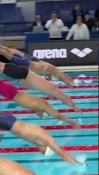
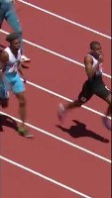
WHAT FITNESS COMPONENT ARE THESE ATHELETES EXHIBITING?
A. CARDIOVASCULAR ENDURNACE
B. MUSCULAR STRENGTH
C. MUSCULAR ENDURANCE
D. BODY COMPOSITION
E. FLEXIBILITY

Slide 36
STATIC STRETCHING: QUIZ QUESTION
1) WHAT IS STATIC STRETCHING?
STRETCHING WHILE MOVING AND BOUNCING
STRETCHING THAT INVOLVES QUICK, JERKY MOTIONS
STRETCHING AND HOLDING A POSITION WITHOUT MOVEMENT
STRETCHING ONLY YOUR UPPER BODY
2) WHEN IS STATIC STRETCHING MOST EFFECTIVE?
BEFORE STARTING ANY PHYSICAL ACTIVITY
DURING INTENSE EXERCISE OR SPORTS
AFTER COMPLETING A WORKOUT OR ACTIVITY
DURING A SHORT BREAK IN THE MIDDLE OF AN ACTIVITY

Slide 37
DYNAMIC STRETCHING: QUIZ QUESTION
1) WHAT IS DYNAMIC STRETCHING PRIMARILY FOCUSED ON?
HOLDING A STRETCH POSITION FOR AN EXTENDED TIME
ACTIVELY MOVING DURING STRETCHES
RELAXING AND BREATHING DEEPLY
SITTING STILL WHILE STRETCHING
2) WHICH OF THE FOLLOWING IS AN EXAMPLE OF DYNAMIC STRETCHING?
HOLDING ONTO YOUR TOES AND COUNTING TO 30
REPEATEDLY SWINGING YOUR LEG FORWARD AND BACKWARD
TOUCHING YOUR TOES AND STAYING IN THAT POSITION
LYING DOWN AND PULLING YOUR KNEES TO YOUR CHEST

Slide 38
FLEXIBILITY: QUIZ QUESTION
1) WHAT DOES FLEXIBILITY REFER TO?
THE ABILITY TO RUN VERY FAST
THE NUMBER OF MUSCLES YOU HAVE IN YOUR BODY
THE RANGE OF MOTION IN YOUR JOINTS AND MUSCLES
THE NUMBER OF BONES IN YOUR BODY
2) WHY IS FLEXIBILITY IMPORTANT?
IT HELPS YOU GAIN WEIGHT AND MUSCLE MASS
IT CAN MAKE YOU TALLER AS YOU GROW OLDER
IT REDUCES THE RISK OF INJURY AND HELPS WITH MOVEMENT
IT ONLY MATTERS FOR PROFESSIONAL ATHLETES

Slide 39
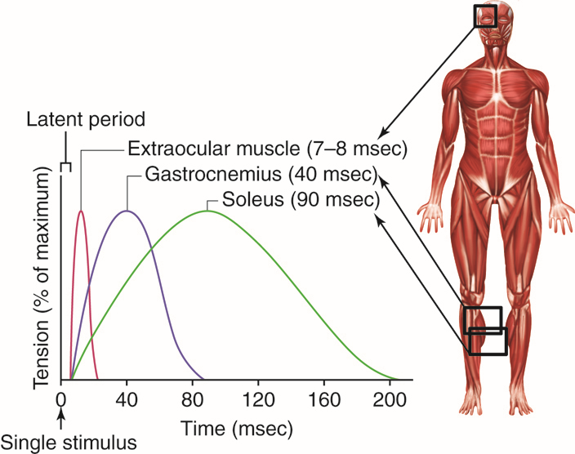
MAJOR MUSCLE RECAP

Slide 40
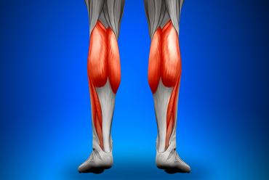
CALVES

Slide 41
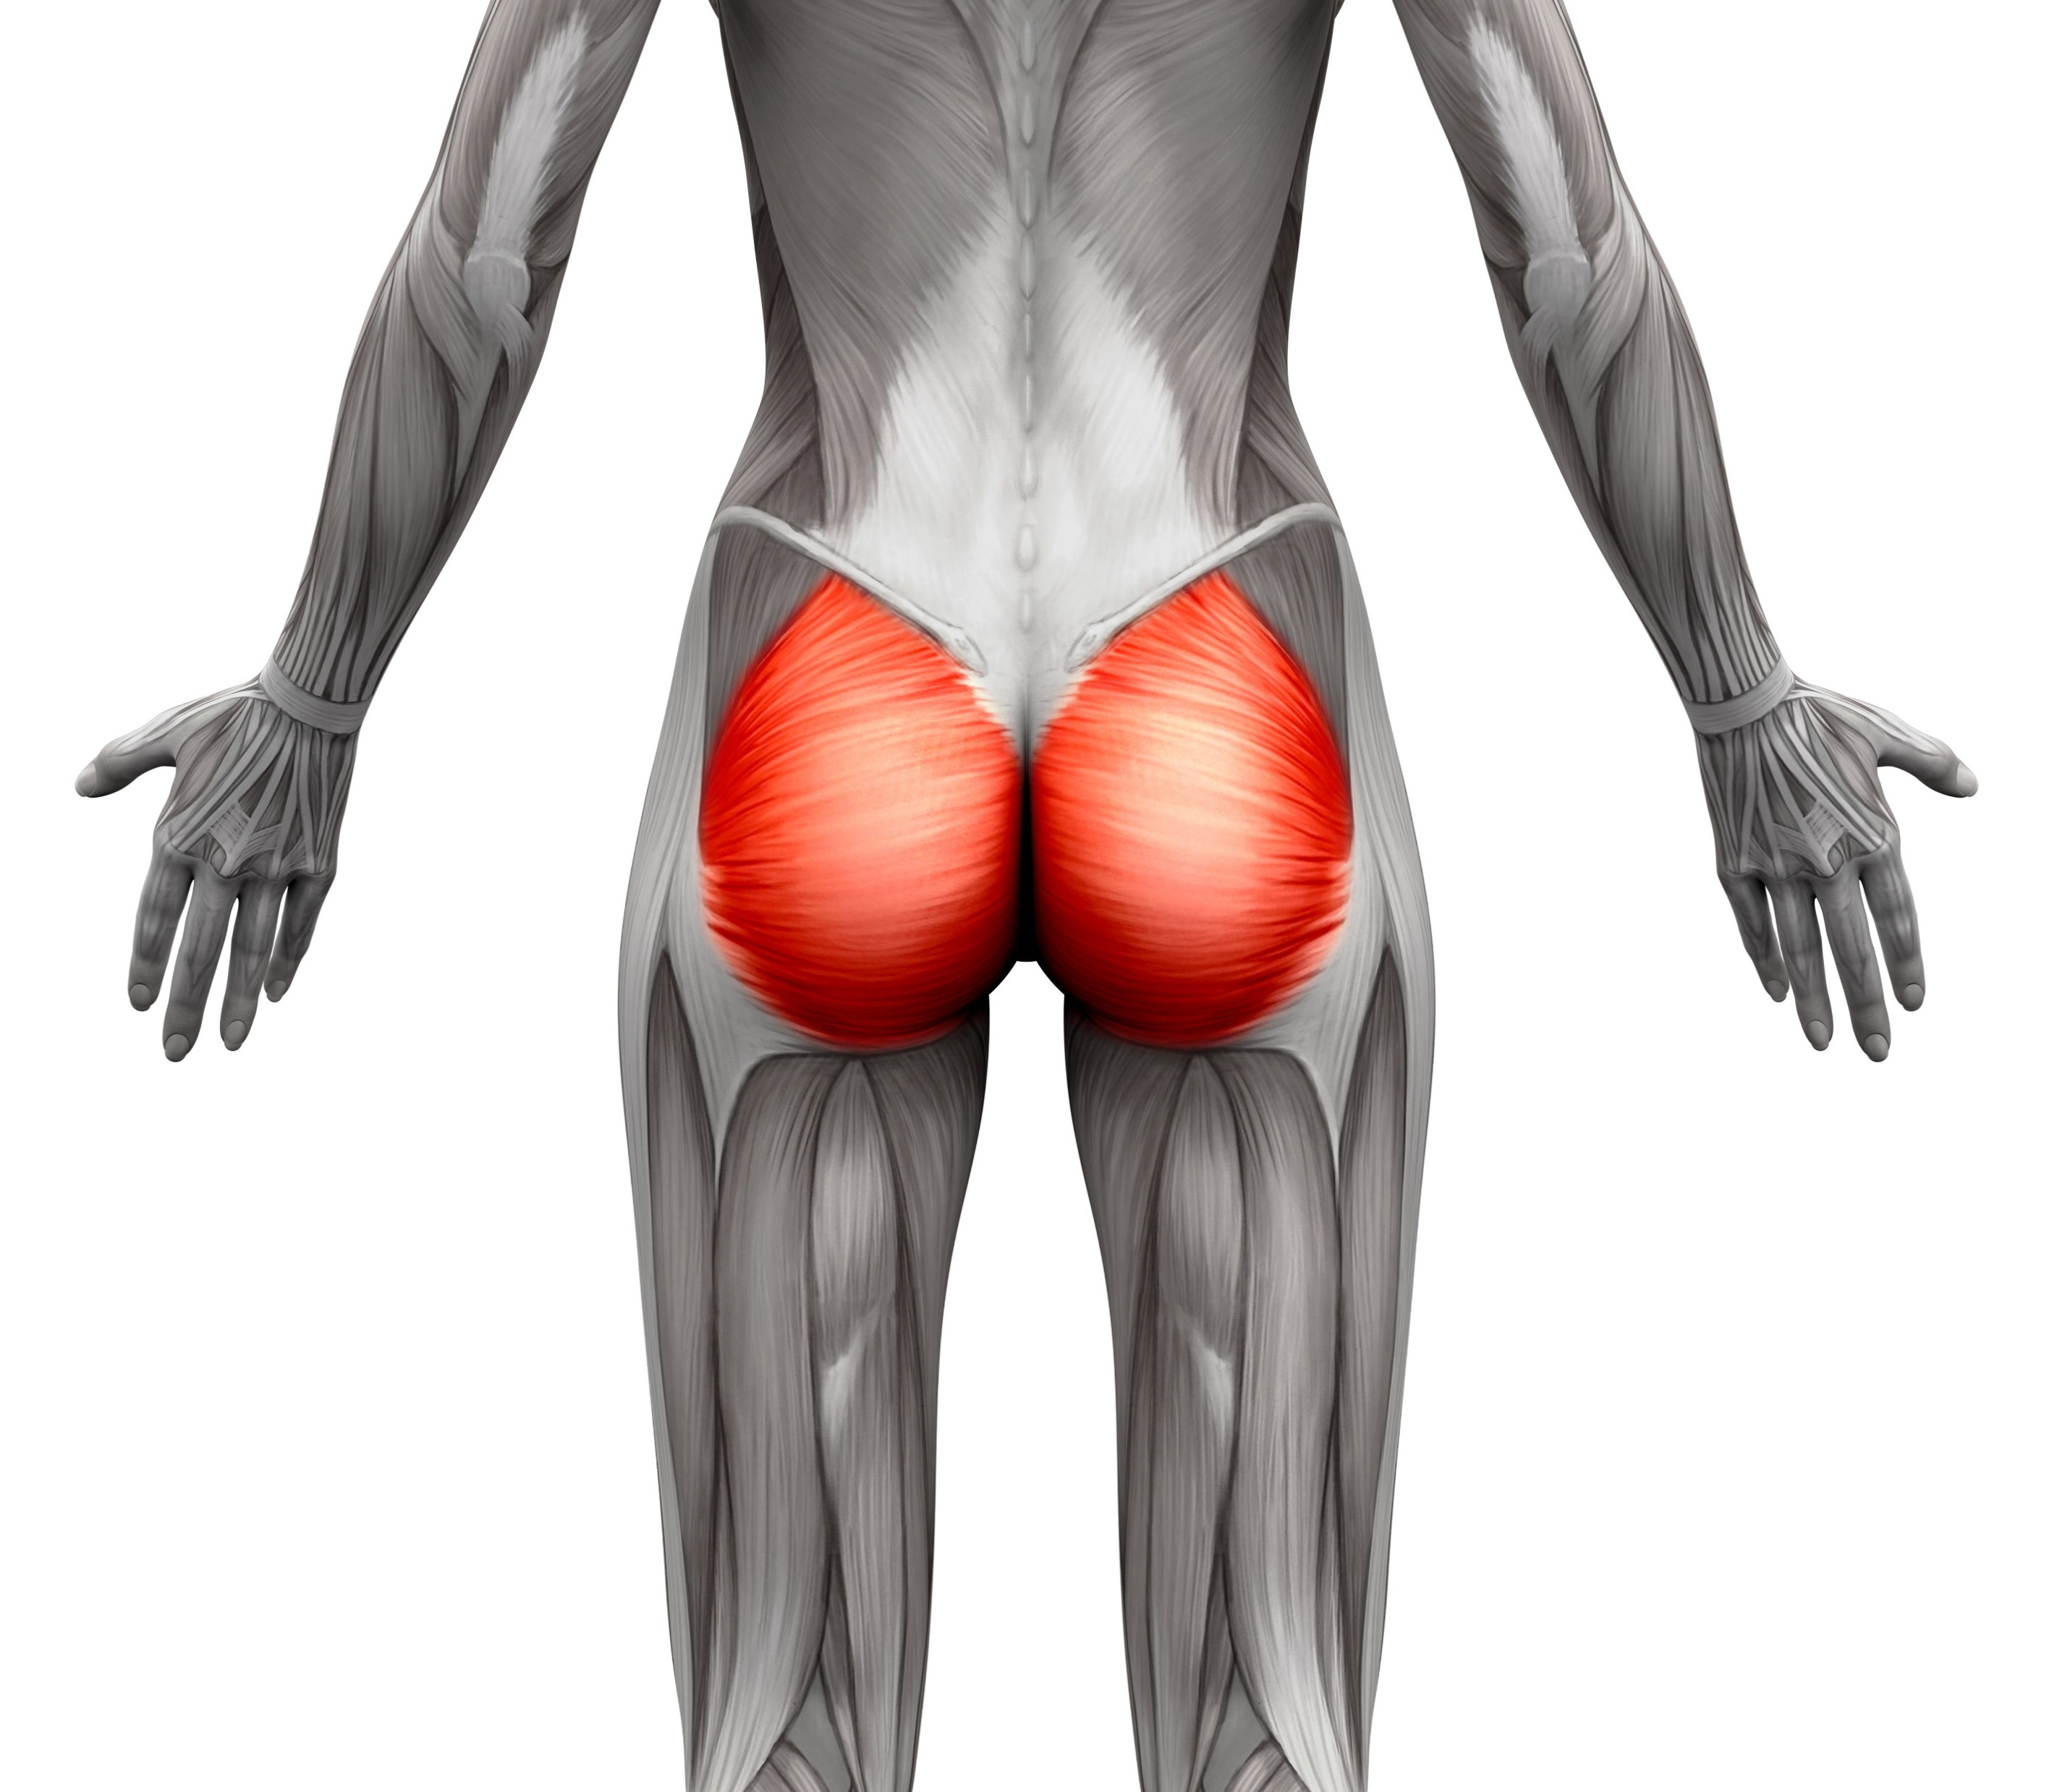
GLUTES

Slide 42
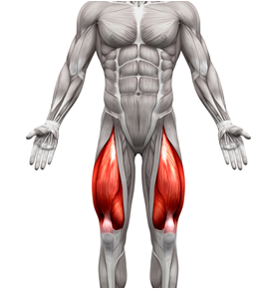
QUADRICEPS/ QUADS

Slide 43
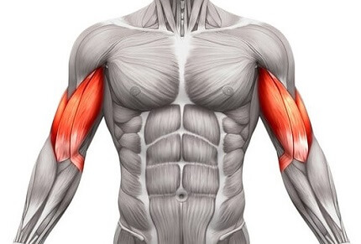
BICEPS

Slide 44
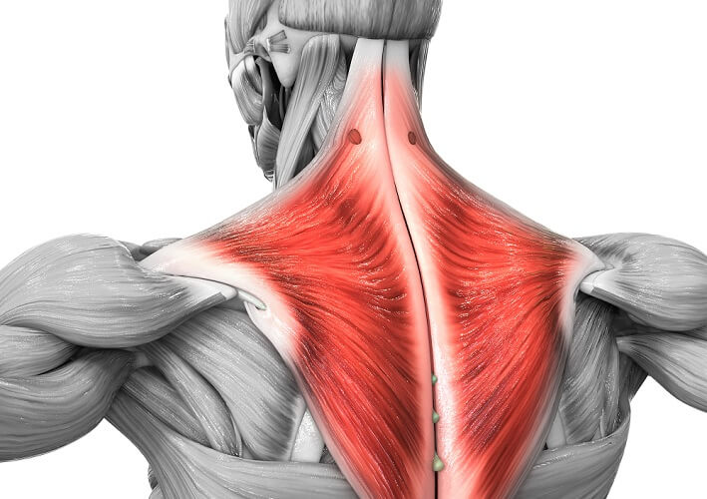
TRAPEZIUS/ TRAPS

Slide 45
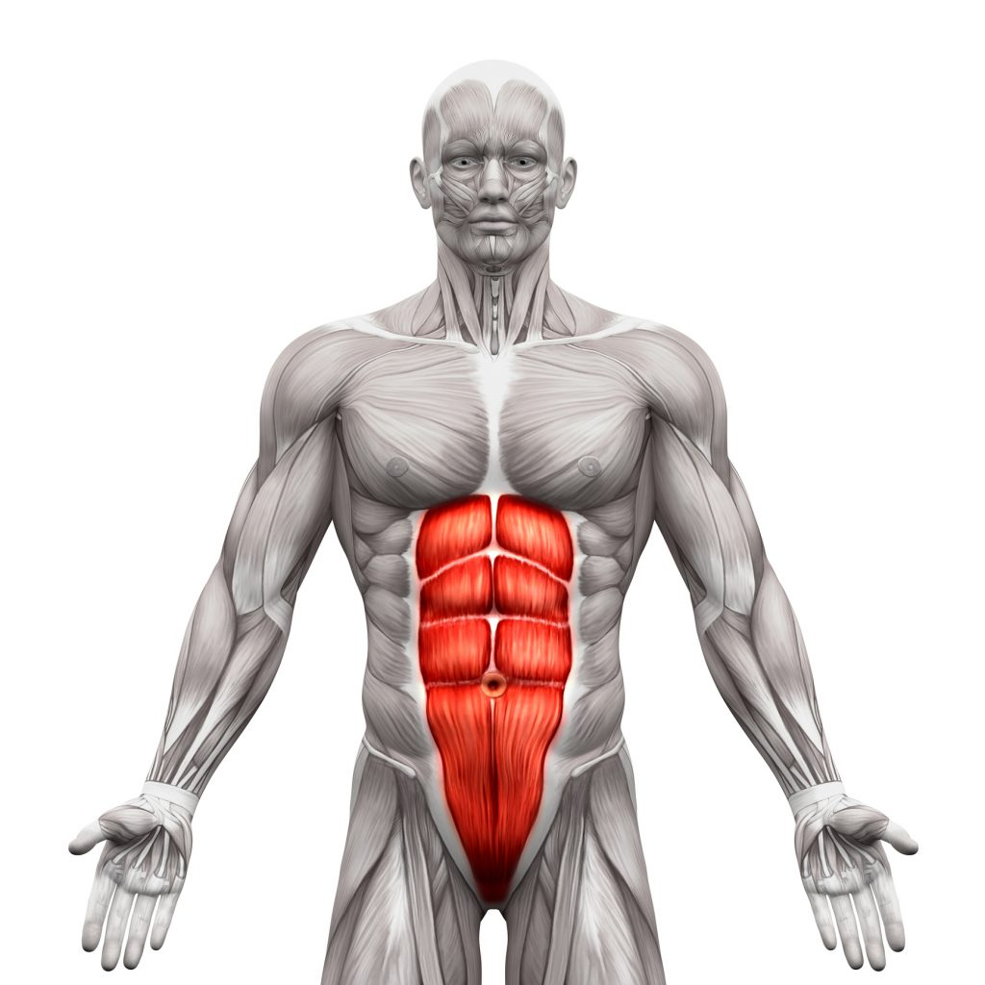
ABDOMINALS

Slide 46
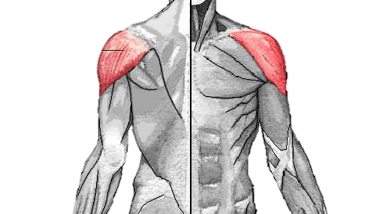
DELTOIDS

Slide 47
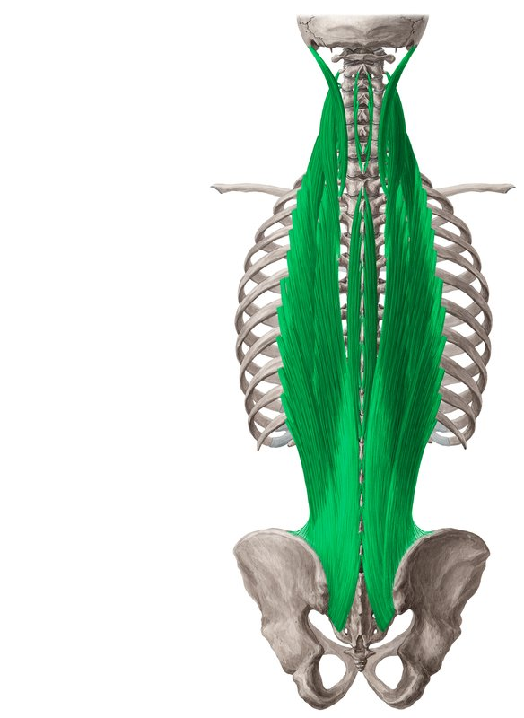
ERECTOR SPINAE

Slide 48
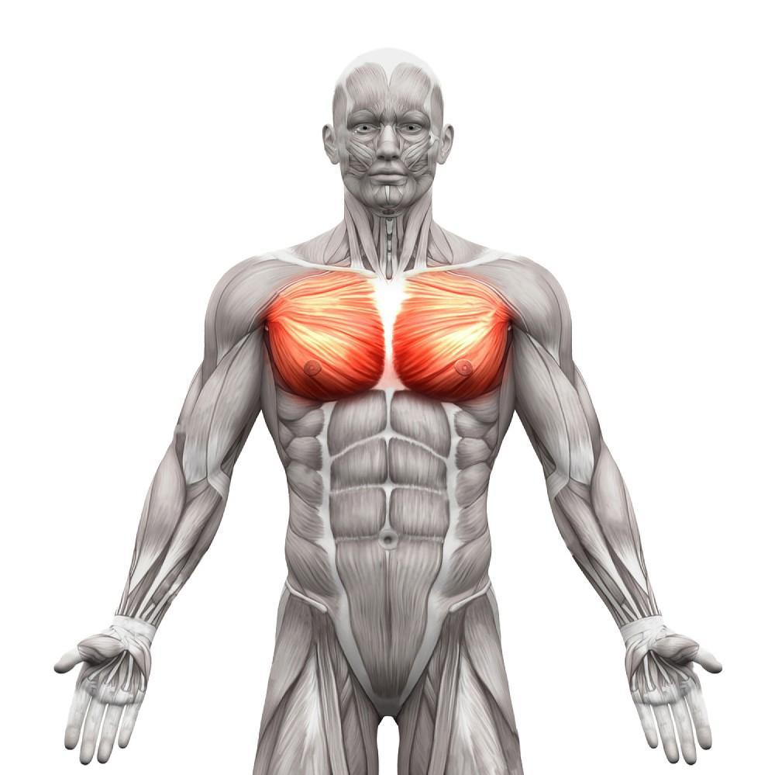
PECTORALIS

Slide 49
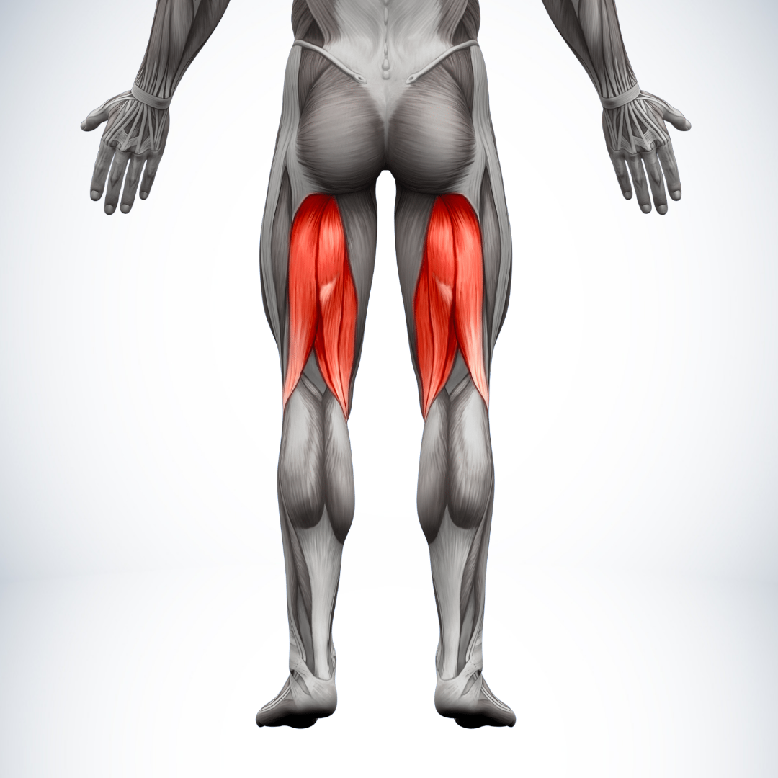
HAMSTRINGS

Slide 50
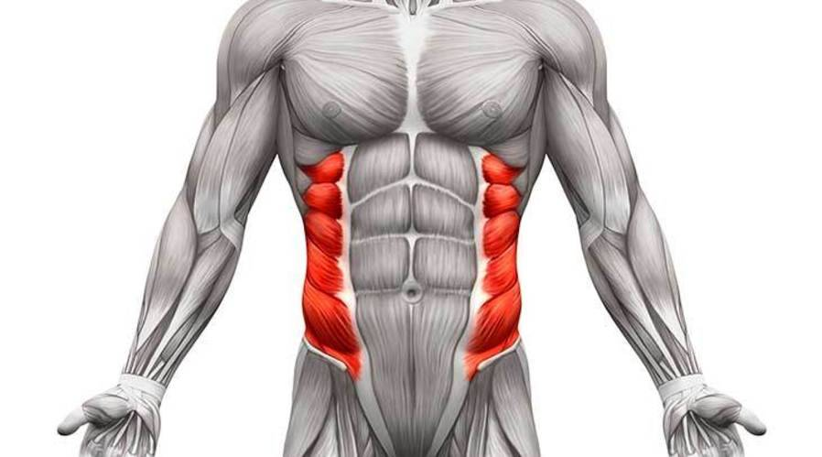
OBLIQUES

Slide 51
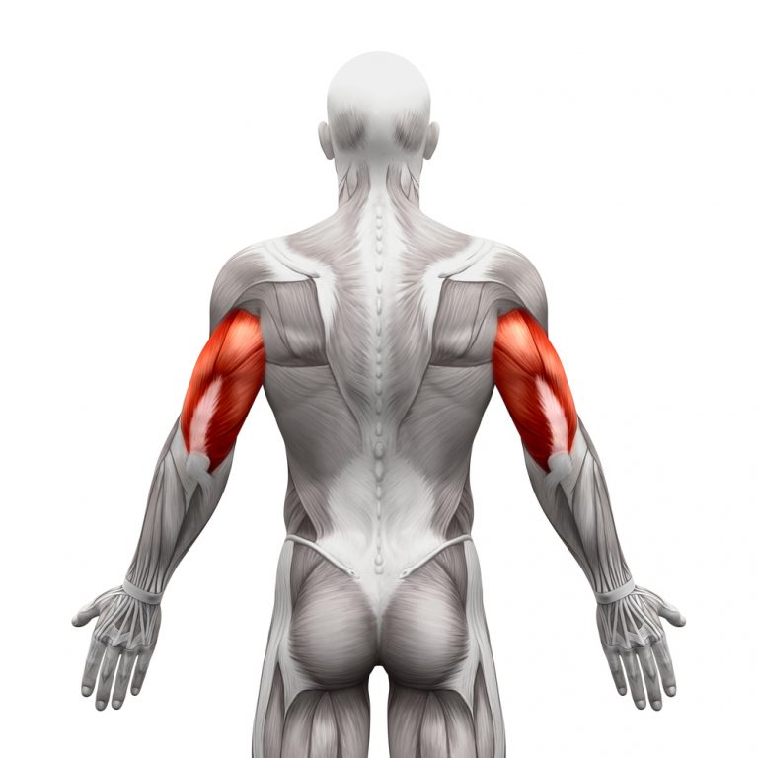
TRICEPS

Slide 52
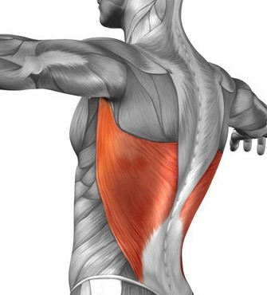
LATS

Slide 53
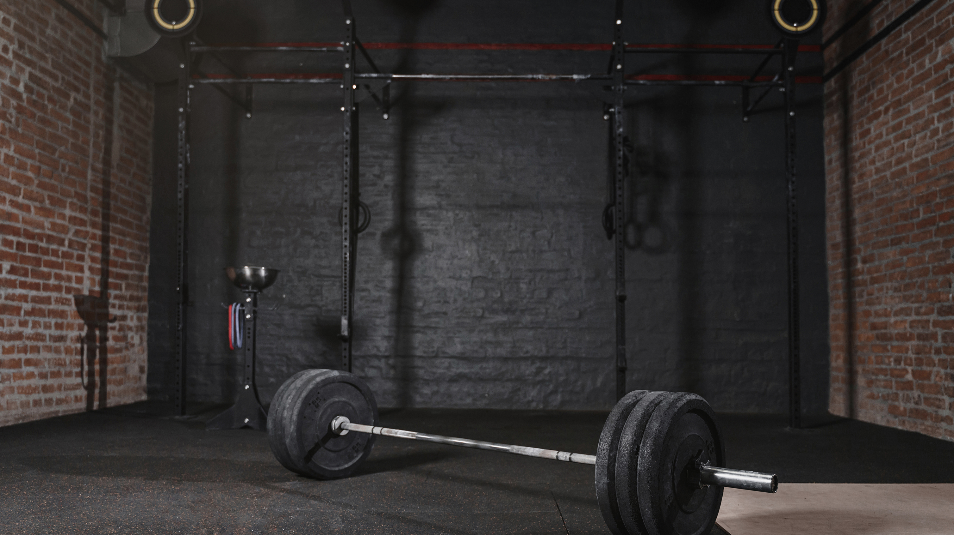
CIRCUIT TRAINING REVIEW

Slide 54
REVIEW: DEFINE CIRCUIT TRAINING.
A COMBINATION OF DIFFERENT EXERCISES EITHER TIMED OR REPETITION BASED.
EXAMPLE: THREE 30 SECONDS ROUNDS CONTAINING 5 EXERCISES.

Slide 55
TRUE or FALSE: CIRCUIT TRAINING CAN IMPROVE MUSCULAR STRENGTH, MUSCULAR ENDURANCE AND YOUR CARDIOVASCULAR ENDURANCE SIMULTANEOUSLY?
TRUE

Slide 56

NAME THREE CIRCUIT TRAINING EXERCISES?

Slide 57

CORE STRENGTH REVIEW

Slide 58

CORE STRENGTH REVIEW QUESTIONS
1. TRUE OR FALSE: YOU ACTIVATE YOUR CORE TO REACH DOWN FOR AN OBJECT?
TRUE.
2. TRUE OR FALSE: A TENNIS PLAYER ACTIVATES THEIR CORE WHEN THEY SWING THEIR RACKET TO GET THE BALL OVER THE NET?
TRUE.
3. TRUE OR FALSE: THE CORE HELPS TO SUPPORT AND STABILIZE YOUR SPINE.
TRUE.
4. TRUE OR FALSE: A WEAK CORE EQUALS GOOD BALANCE AND STABILITY.
FALSE, A STRONG CORE EQUALS GOOD BALANCE AND STABILITY.
5. TRUE OR FALSE: A STRONG CORE CAN HELP PREVENT INJURIES.
TRUE.
6. TRUE OR FALSE: A STRONG CORE AIDS IN GOOD POSTURE.
TRUE.

Slide 59
DO YOU NEED A GYM TO WORK ON YOUR CORE?
NO

Slide 60
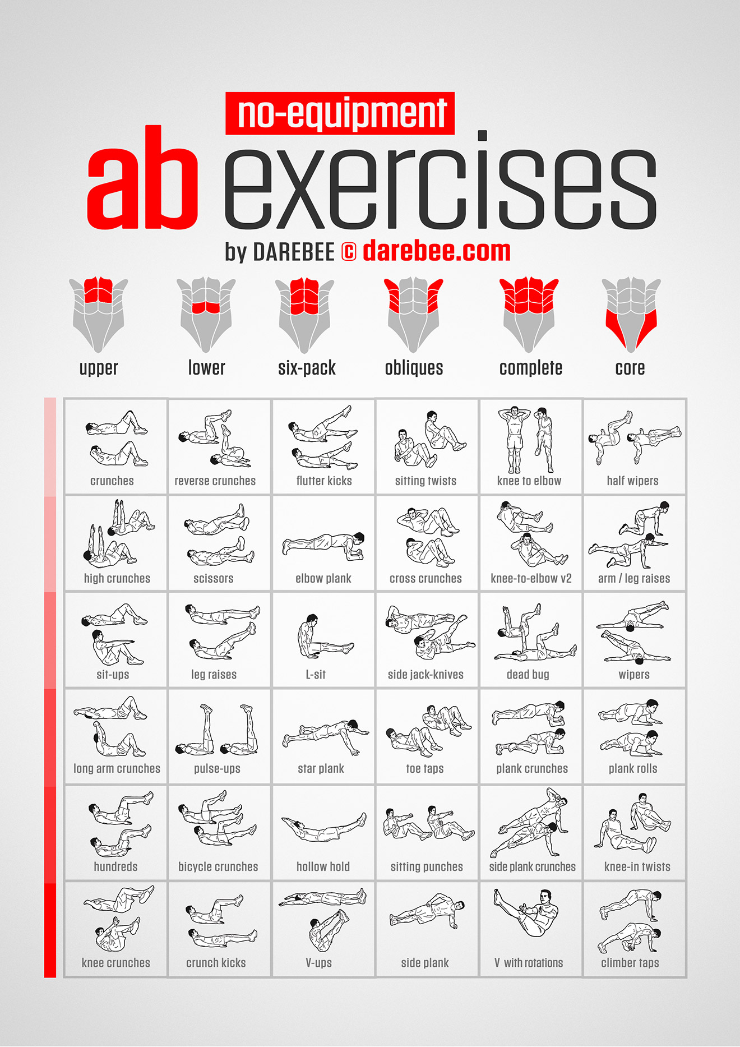
WHAT EXERCISES IS THE ILLUSTRATION FOCUSING ON?
CORE; ABODOMINAL + OBLIQUES

